Slide 1
CCNA (200-125)
Cisco Router’s Boot Sequence
Instructor:
Muhammad Naeem
(MSIT/RHCE/CCNP/CCNA/MCSE)
Cell: 0345-5238281
E-Mail: mna571@yahoo.com

Slide 2
Lecture Overview
Boot Sequence of Cisco Router
Components of Cisco Router

Slide 3
Boot Sequence of Cisco Router
Router for the first time is configured through the CONSOLE port.COM port of a PC is connected to the console port of router with a console cable. Router is accessible by a tool in windows, it is called HYPER TEMINAL or any third party software like putty. As soon as the router is powered on and accessed, the following things happen,
POST
BOOT STRAP
FLASH
ROM (mini IOS)
If IOS is Corrupted
NVRAM
Setup Mode
Running Mode

Slide 4
Boot Sequence of Cisco Router
POST:
Hardware components are identified, . and their functionality is tested. Any failure is detected at this stage
Boot Strap:
Boot Strap has two functionalities;
1. Finding IOS
2. Loading IOS
The IOS is found and then loaded, by the value pointing by configuration register.
Configuration Register:
Configuration register pointing a valid IOS to load, based on its values. e.g the defualt value of config register is 0 x 2102, it means load the IOS from Flash memory. Cofiguration Register is Hexadecimal value.
Configuration Register (Continued):

Slide 5
Boot Sequence of Cisco Router
Configuration Register (Continued):
15 -----------|------------|------------ |3 2 1 0
Hexadecimal Values ABCDEF 0-9
8 4 2 1
0 0 0 0=0 → (ROM Monitor)
0 0 0 1=1 → (Rx Boot)
Anything else,
0 0 1 0=2
1 1 1=F
→ (Flash, NVRAM)
ROM Monitor:
Low Level Testing, Troubleshooting like safe mode
RX Boot:
Download IOS image to Router, Update IOS
Flash:
A memory to store IOS of Router;
1. Intel EPROM
2. Slot with PCMCIA Cards

Slide 6
Boot Sequence of Cisco Router
NVRAM: (Non Volatile Random Access Memory)
It is a re-write able memory area that holds router’s configuration file. NVRAM retains the information when ever router is rebooted. Once configuration is saved, it will be saved in NVRAM and this configuration is called Startup Configuration.
RAM: (Random Access Memory)
RAM holds running IOS configurations and provides caching. RAM is a volatile memory and looses its information when router is turned off. The configuration present in RAM is called Running configuration.
Setup Mode:
In Setup mode, there will be a message, “Would You Like To Enter The Initial Configuration [Y/N]” : If “Y” then, initial configuration starts. If “N” would you like to terminate the auto installation? Press “RETURN” to get started……You will land on the default prompt of the Router “ ROUTER >”.

Slide 7
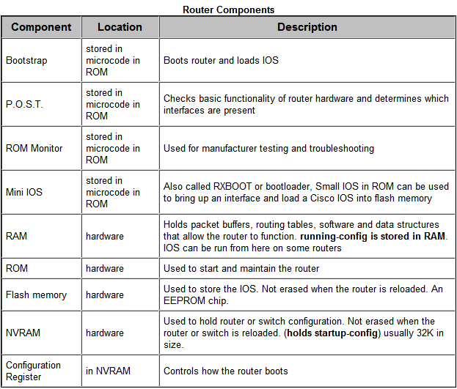

Slide 8
Practical Session
Router’s Basic Configuration
How to use commands
Getting help on commands
Setting interfaces (Ethernet/Fast Ethernet, Serial)
Configuring Lines (Console,VTY etc)
Setting Security
User Password
Enable Password
Lines Password

